Slide 1
Protecting your Computer
The things you MUST know

Slide 2
Overview
The Basics of protection:
  Placement of your computer
  Powering your computer
  Heat, your computer’s worst enemy
  Caring for your computer & Physical damage
Protecting your computer against:
  Data Loss
  Viruses
  Hackers
  Spam
  Theft

Slide 3
Placement of your Computer
Your computer is composed of many sensitive parts. In placing your computer you should avoid locations that would put your computer at risk of:
  Falling or Tipping over
  Having things fall on them
  Having things spill on them
  Being exposed to moisture
  Being exposed to excessive dust

Slide 4
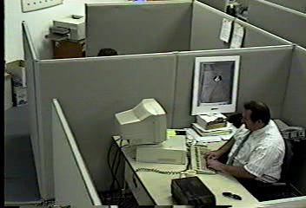
Hard Drives are EXTREMELY Sensitive!

Slide 5
Powering your computer
A clean, steady power source is essential to stable computer operation. Your computer’s power supply has specific operating voltages that it must maintain in order for your computer to operate.

Slide 6
Heat: Your computer’s worst enemy
As computer get faster, their components get hotter. Some hard drives and processors produce enough heat to burn you if you were to touch them. And that much heat is just as bad for a computer as it is for you.
Computers use fans to cool their components. These fans draw in the cooler outside air and circulate it throughout the case. But along with the cooler air comes dust. Dust is notorious for getting into the fan’s ball bearings, and once the dust mixes with the lubricants it forms a near solid and causes the fan to stop spinning.

Slide 7
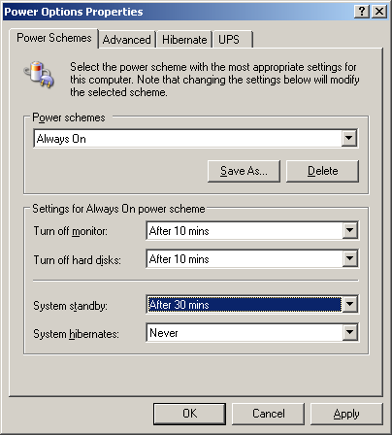
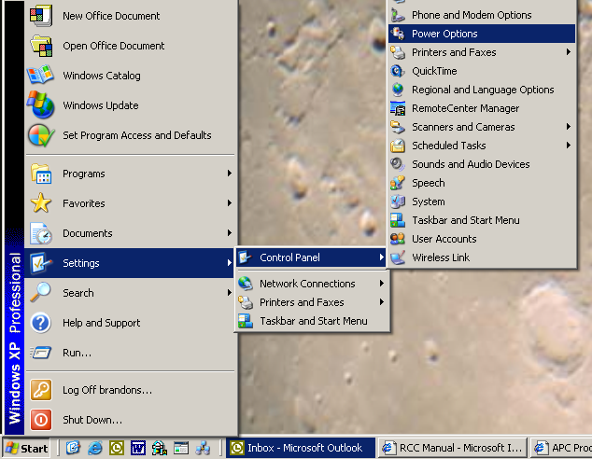
Heat: Your computer’s worst enemy

Slide 8
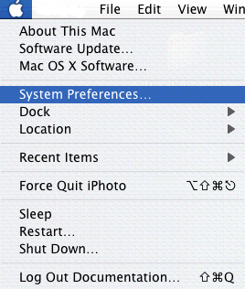
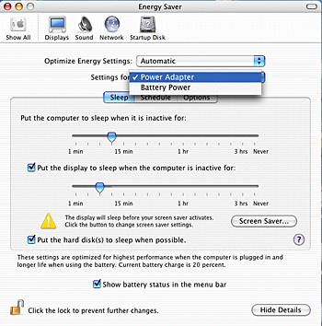
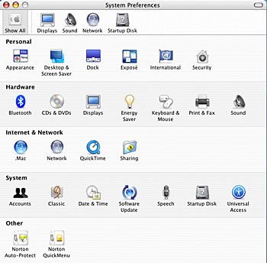
Heat: Your computer’s worst enemy

Slide 9
Cleaning Your Computer
Many people don’t clean their computer simply because they don’t know how. However, failure to clean your computer is the cause for most hardware failures. Here are a few ways to keep your computer clean:
  Keep the room that your computer is in clean because any dirt and dust that accumulates in the room will eventually make its way inside your computer.
  Desktops: Unplug your computer and remove the side panel, then use a can of compressed air to blow out your computer. A small vacuum will also work for this. Also blow out your keyboard and any other visible dust.
  Laptops: Locate the air vents on your laptop, these are generally on the side towards the rear, and use a can of compressed air to blow out the inside of your laptop. You can also blow out the keyboard

Slide 10
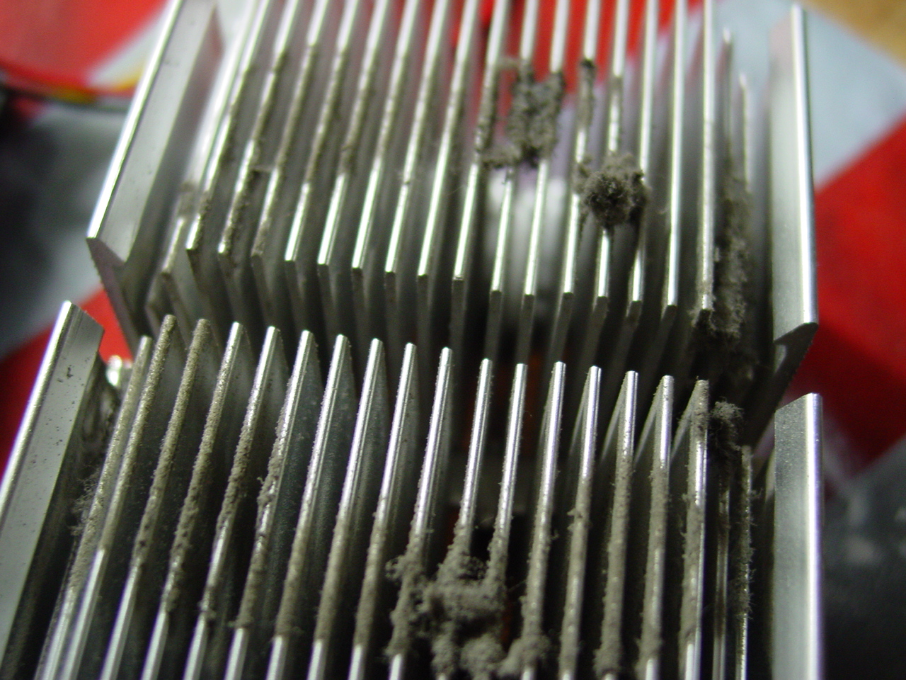

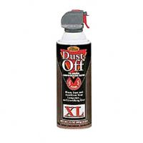
Cleaning Your Computer

Slide 11
Protecting against Data Loss
  Keep backups, there are a variety of cheap backup mediums today. CDR’s or DVD-R’s are one of the most cost effective methods of backing up large amounts of data. Zip drives & Jazz drives are also popular methods of backing up data onto disks.
  Save your work often. Or better yet set the Autosave feature in Microsoft Word to 2 or 3 minutes. This can be found under Tools→Options→Save for PC and under Edit→Preferences→Save for Macs.

Slide 12
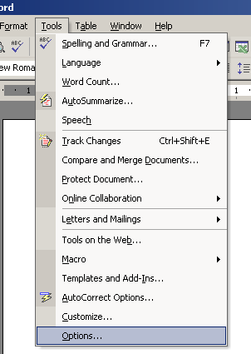
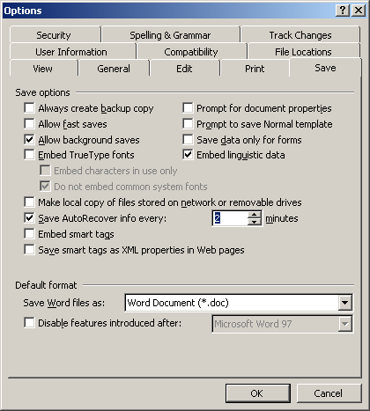
Preventing Against Data Loss

Slide 13
Protecting Against Viruses
  LOGIC BOMB
  BOOT SECTOR
  TROJANS
  WORMS

Slide 14
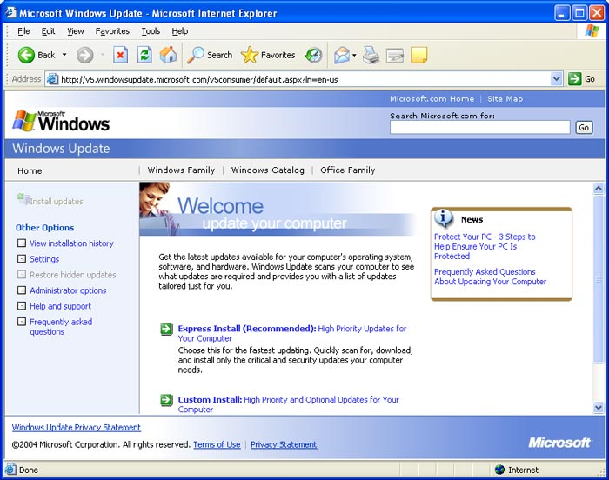
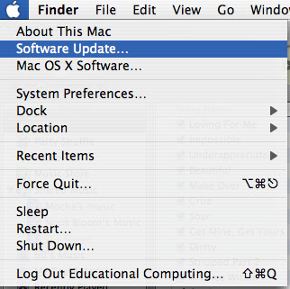
OS Updates

Slide 15
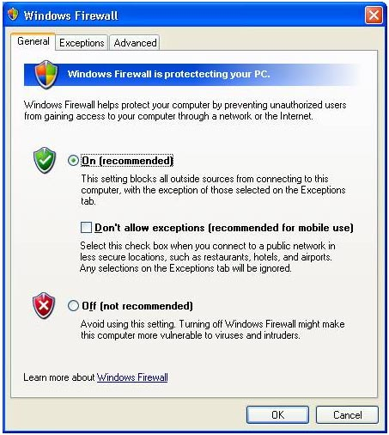
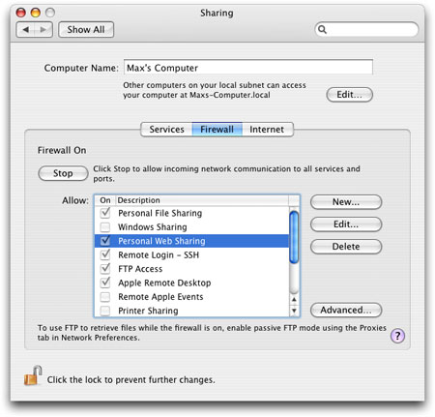
Firewalls

Slide 16
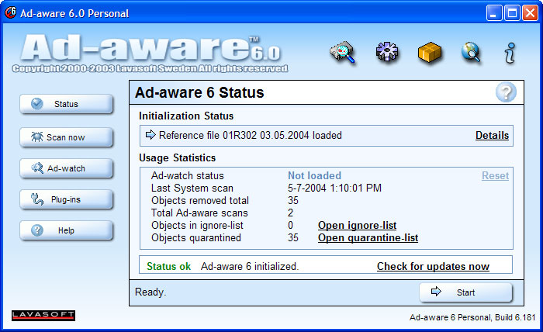
Spyware Removal Tools

Slide 17
Questions?

